Slide 1
Microservices Patterns

Slide 2
Aggregator Pattern

Slide 3
Aggregator Pattern
In a microservices architecture, individual services handle specific business functionalities.
However, modern applications often require data from multiple services to be aggregated into a single response.
The Aggregator Design Pattern provides a structured approach to achieving this, ensuring efficiency, performance, and better client experience.

Slide 4
What is the Aggregator Design Pattern?
Definition
The Aggregator Pattern is a microservices design pattern where a service collects responses from multiple independent microservices and merges them into a unified response for the client.
Key Concept:
A client makes a single request.
The Aggregator Service fetches required data from multiple microservices.
It processes and merges responses.
The client receives a combined response instead of calling each service separately.

Slide 5
Aggregator Patterns
Service to Service communication
Inter service communication
Chained communication

Slide 6
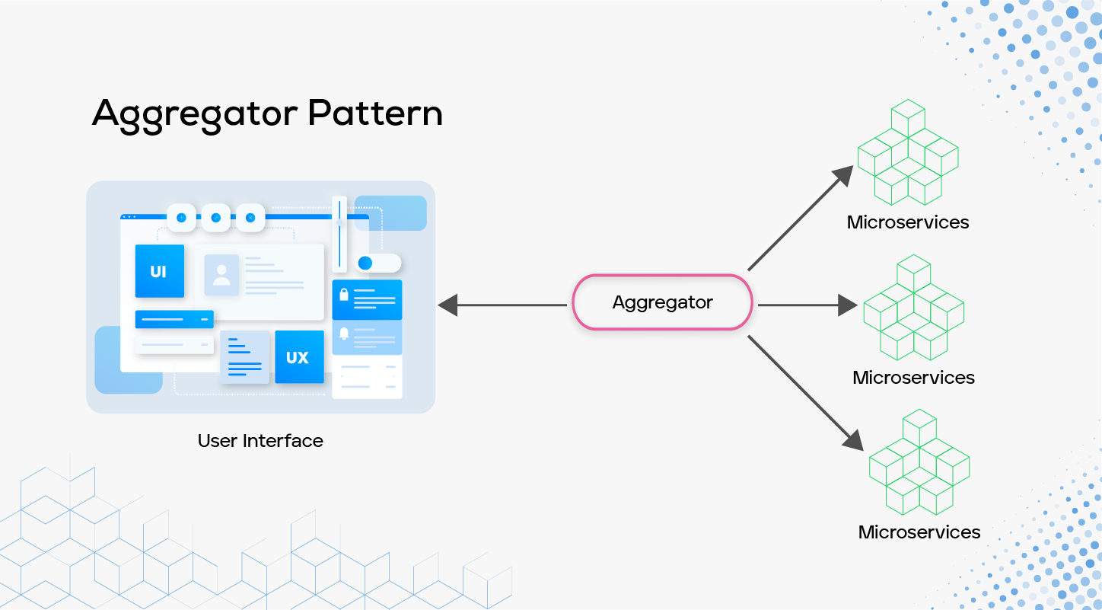
Aggregator Pattern

Slide 7
Why Use the Aggregator Pattern?
Key Benefits
Simplifies Client API Calls – Reduces the number of requests needed from the client.
Reduces Network Load – Instead of multiple requests, one optimized call is made.
Improves Performance – Aggregates only the required data.
Enhances Security – Prevents direct client access to all microservices.
Better Maintainability – Keeps microservices independent while optimizing client-side consumption.

Slide 8
Challenges & Solutions
Challenge | Solution
Increased Latency | Use asynchronous calls
Single Point of Failure | Deploy the aggregator as a highly available service
Data Inconsistency | Implement event-driven updates for data synchronization

Slide 9
Key Points
The Aggregator Design Pattern simplifies microservices data retrieval by combining multiple API responses into a single response. This enhances performance, security, and scalability.
Reduces network overhead.
Improves performance and client-side simplicity.
Ensures modular and scalable microservices communication.

Slide 10
Implementation
Scenario:
A customer requests an order summary, which includes:
Product details (Product Service)
Order details (Order Service)
Payment status (Payment Service)
Instead of calling multiple microservices, the Aggregator Service collects, merges, and returns the data in a single API response.

Slide 11
Communication Pattern

Slide 12
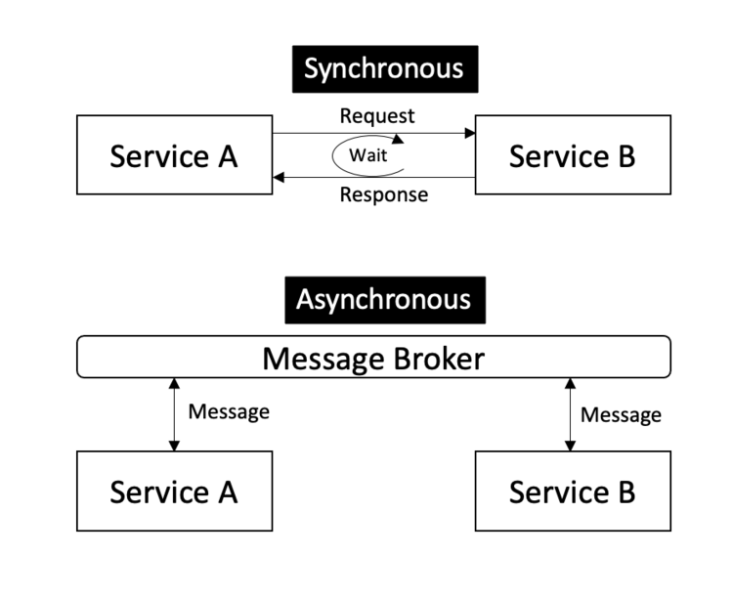
Two ways Microservices communicate

Slide 13
Communication Patterns
Synchronous Communication:
one service directly calls another using REST APIs.
In this pattern, Service A calls Service B and waits for a response before proceeding — typically using HTTP REST APIs.

Slide 14
Core Principles
Principle | Description
Single Responsibility | Each service should do one job and delegate others via synchronous calls.
Timeout & Retry Management | Prevent hanging requests or retry storms.
Error Isolation | Failure in Service B shouldn’t cascade and crash Service A.
Backpressure Control | Avoid overloading downstream services with too many synchronous calls.

Slide 15
Best Practices for Synchronous Communication
Use RESTful Design Principles
Use API Gateway (for clients)
Handle Failures Gracefully
Avoid Deep Call Chains
Secure Inter-Service Communication
Avoid Overusing Synchronous Calls

Slide 16
1. Use RESTful Design Principles
Use appropriate HTTP verbs (GET, POST, PUT, DELETE)
Use resource-oriented URIs (e.g., /api/customers/123)
Support status codes (e.g., 200 OK, 404 Not Found, 500 Internal Server Error)
Return standardized JSON responses

Slide 17
2. Use API Gateway (for clients)
Route external traffic through an API Gateway
Avoid clients directly accessing internal services
Helps with routing, security, logging

Slide 18
3. Handle Failures Gracefully
Use try/catch around HTTP calls
Return meaningful error responses
Don’t expose internal exception messages

Slide 19
4. Avoid Deep Call Chains
Avoid chaining 4-5 services synchronously (leads to high latency and tight coupling)
Consider Aggregator or Asynchronous messaging if more than 2 services are involved

Slide 20
5. Secure Inter-Service Communication
Use JWT tokens, OAuth2, or API keys between services
Add service-to-service authentication and authorization

Slide 21
6. Avoid Overusing Synchronous Calls
Use this pattern only when:
You need immediate response
The caller is fine waiting
The callee is available and reliable
If not, consider asynchronous patterns like messaging (RabbitMQ, Kafka) or event-driven architecture.

Slide 22
When to Use Synchronous Communication
Use Case | Is Synchronous Suitable?
Get customer details during login | ✅ Yes
Send email notification | ❌ No (Use async message queue)
Fetch product list in real-time | ✅ Yes
Update analytics dashboard | ❌ No (Use event stream)

Slide 23
API Gateway Pattern

Slide 24
API Gateway Pattern
The API Gateway acts as a single entry point. Instead of connecting to multiple services, the client sends one request to the gateway, and it routes the request to the right services. It acts as a reverse proxy.
How It Works:
Client sends a request to the API Gateway.
Gateway forwards the request to the appropriate service(s). Authenticates if needed.
Gateway can combine responses if needed and send them back to the client.

Slide 25
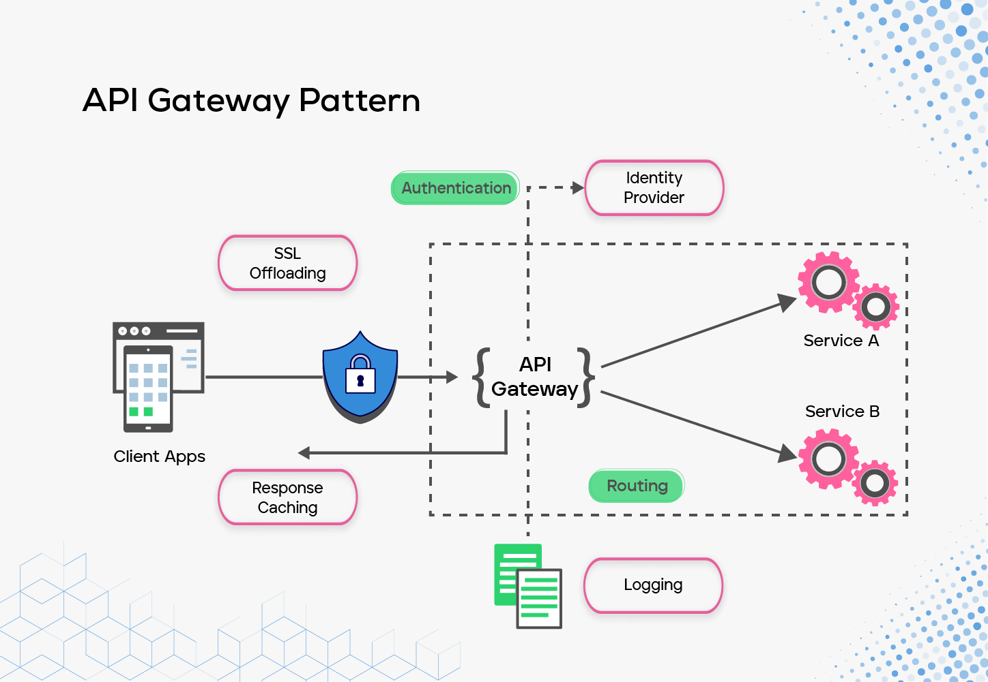
API Gateway Pattern

Slide 26
API Gateway Pattern
Features:
Routing: Directs client requests to the appropriate microservice.
Authentication & Authorization: JWT, OAuth2, API keys, etc.
Load Balancing: Distributes requests to multiple service instances.
Request Aggregation: Combines data from multiple services.
Caching: Improves performance for frequently requested data.
Rate Limiting & Throttling: Prevents abuse.
Logging & Monitoring: Centralized observability.

Slide 27
API Gateway Pattern
Benefits:
Decouples clients from microservices
Reduces client complexity (they don’t need to know each service)
Enables fine-grained security policies
Improves developer productivity (central point for API changes)
Supports cross-cutting concerns in one place

Slide 28
API Gateway Pattern
Challenges:
Single Point of Failure: If the gateway fails, the entire system may become unreachable.
Complex Logic: Overloading the gateway with business logic can violate SRP (Single Responsibility Principle).
Scalability: Needs horizontal scaling to handle large traffic.
Security Risks: A compromised gateway can expose all services.

Slide 29
Service Discovery Pattern

Slide 30
Service Discovery Patterns
What is Service Discovery?
In microservices, services often scale up/down dynamically, and their IP addresses may change. Service discovery allows services to find each other automatically.
Following Pattern Types used:
Type | Description | Responsibility
Client-side Discovery | Client queries the service registry to get service IP/Port and chooses which one to call. | Client
Server-side Discovery | Client sends request to API Gateway / Load Balancer, which queries the registry and routes to service. | Gateway/Server

Slide 31
Service Discovery Patterns
When to Use What?
Feature | Client-side Discovery | Server-side Discovery (via Gateway)
Control | Client selects instance | Gateway handles routing
Complexity | Higher in client code | Centralized
Load Balancing | Custom in client | Gateway can use built-in algorithms
Popular in | Internal services | External requests via gateway

Slide 32
Load Balancing
In API Gateway, load balancing helps distribute traffic across multiple downstream service instances.
It supports multiple load balancing strategies which you can configure.

Slide 33
Types of Load Balancing in Ocelot
1. RoundRobin (Default)
How it works: Requests are distributed sequentially across all instances.
2. LeastConnection
How it works: Chooses the instance with the fewest active requests.
3. NoLoadBalancer
How it works: Ocelot selects the first available service instance.
Use case: Useful when you want full control of downstream routing logic.

Slide 34
Database Per Service Pattern

Slide 35
Database Per Service Pattern
Each service is responsible for its own data management in a microservices architecture.
The Database Per Service Pattern ensures that every microservice has its own dedicated database instead of sharing a single monolithic database.
This approach enhances scalability, autonomy, and data consistency across microservices.

Slide 36
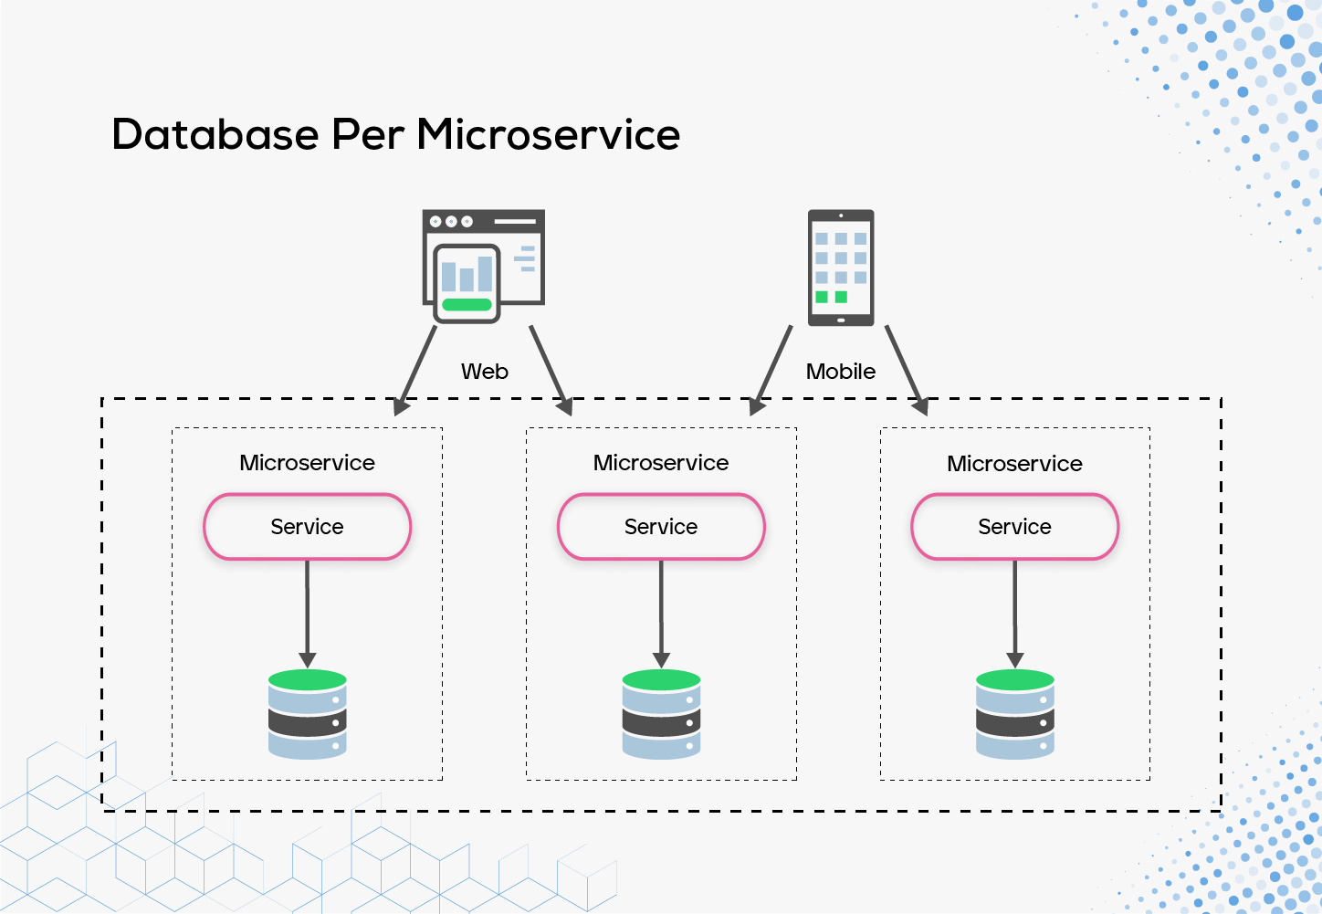
Database Per Service Pattern

Slide 37
Database Per Service Pattern
Key Concept:
Each microservice manages its own database.
Other microservices cannot directly access another service’s database.
Data is synchronized using APIs, events, or messaging systems (Kafka, RabbitMQ, etc.)
This pattern eliminates tight coupling between services.

Slide 38
Why use the Database Per Service Pattern
Key Benefits
Service Autonomy – Microservices can be developed, deployed, and scaled independently.
Data Isolation – Prevents one service from affecting another due to database changes.
Technology Flexibility – Different services can use different databases (SQL, NoSQL, etc.) based on requirements.
Improved Security – Access control is better as services don’t share a database.
Better Performance – Each service optimizes queries for its own workload.
Decentralized Scalability – Enables independent scaling of databases per service.

Slide 39
Challenges of the Database Per Service Pattern
Challenge | Solution
Data Duplication | Use event-driven architecture to synchronize data efficiently.
Data Consistency | Implement saga pattern or distributed transactions to manage consistency.
Query Complexity | Use API composition or CQRS (Command Query Responsibility Segregation) to fetch data from multiple services.
Cross-Service Reporting | Use event sourcing to gather data for reporting.

Slide 40
Database Per Service vs Shared Database
Feature | Database Per Service | Shared Database
Service Autonomy | ✅ High | ❌ Low
Data Isolation | ✅ High | ❌ Low
Technology Choice | ✅ Flexible | ❌ Limited
Scalability | ✅ Independent | ❌ Tightly Coupled
Cross-Service Queries | ❌ Complex | ✅ Easy

Slide 41
CQRS Pattern

Slide 42
CQRS Pattern in Microservices
What is CQRS?
CQRS (Command Query Responsibility Segregation) is a design pattern that separates reading and writing operations into different models.
Instead of using a single database for both tasks, it introduces two separate models:
Command Model → Handles write operations (Insert, Update, Delete).
Query Model → Handles read operations (Select, Fetch, View).
This means that instead of having one service do both reads and writes, we split it into two services:
One service for handling commands (creating, updating, or deleting data).
Another service for handling queries (fetching and displaying data).

Slide 43
How CQRS Works with Kafka
User sends a command (e.g., create order) → The Command Service writes to the database.
Command Service saves the data in the database and publishes an event to Kafka.
The Query Service listens to the Kafka topic, processes the event, and updates the read database.
User queries for order details → The Query Service retrieves data from the optimized read database.
This architecture ensures better performance by decoupling read and write operations and enables event-driven data consistency

Slide 44
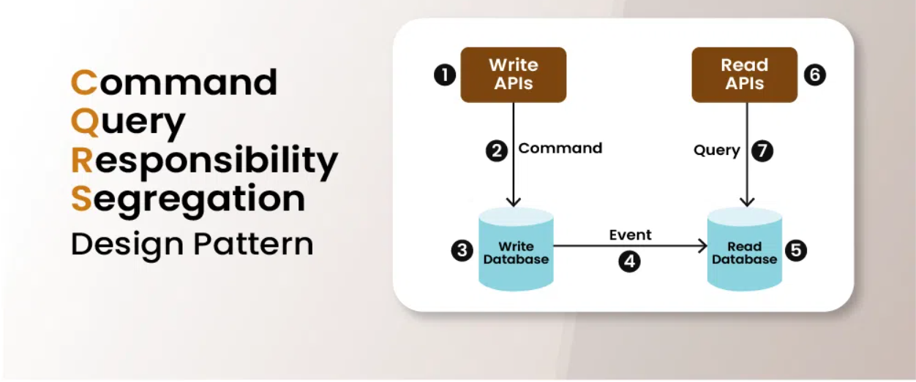
How CQRS Works with Kafka

Slide 45
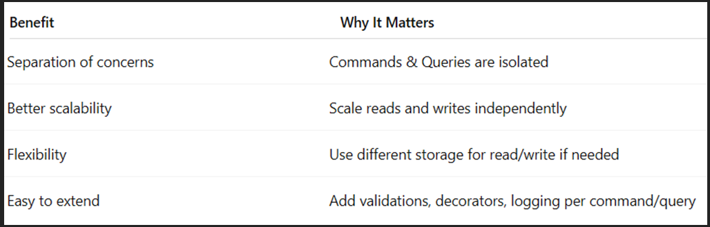
Benefits of CQRS in Microservices

Slide 46
Challenges of using CQRS Design Pattern
Complexity: It can be difficult to coordinate data synchronization, manage distinct read and write models, and guarantee consistency between the two.
Data Synchronization: It might be difficult to keep the read and write models in sync. Maintaining consistency between the read and write models can be challenging
Performance Overhead: Keeping the read model updated in real-time can impact read performance.
Operational Complexity including monitoring, backup and restoration, and guaranteeing data durability and high availability.

Slide 47
Best Practices for implementing CQRS pattern
Separate Read and Write Models Carefully: helps keep each model simple and optimized for its specific task.
Use Asynchronous Communication When Needed: helps the system stay responsive and handle high traffic efficiently, even if some operations take longer.
Keep Commands and Queries as Simple as Possible: Avoid mixing read and write logic in either part to keep things clean and maintainable.
Embrace Event Sourcing for Data Consistency: Event sourcing can be paired with CQRS to keep a record of all changes.
Consider the Complexity of Your System: For simpler systems, CQRS might be overkill and add unnecessary development overhead.

Slide 48
Why Use Kafka in CQRS?
Benefits of Kafka in CQRS
Ensures Eventual Consistency – Query service gets updated asynchronously.
Scalable and Decoupled Architecture – Services do not depend on each other directly.
Handles High Traffic Efficiently – Kafka manages event streams for large-scale applications.
Resilient and Fault-Tolerant – Kafka persists events for future recovery.
By implementing CQRS with Kafka, we achieve separation of concerns, event-driven synchronization, and better scalability.

Slide 49
Circuit Breaker Pattern

Slide 50
Circuit Breaker Pattern
The Circuit Breaker Pattern prevents an application from repeatedly trying to execute an operation that is likely to fail — typically due to a downstream service being unavailable or slow.

Slide 51
Circuit Breaker Pattern
Why and When to Use Circuit Breaker:
Fail Fast: Stops unnecessary calls to failing services and saves system resources.
Service Stability: Helps maintain overall application responsiveness.
Recovery: Provides time for failing services to recover.
Example Scenarios:
External service downtime.
Database outages.
High latency in dependent services.

Slide 52
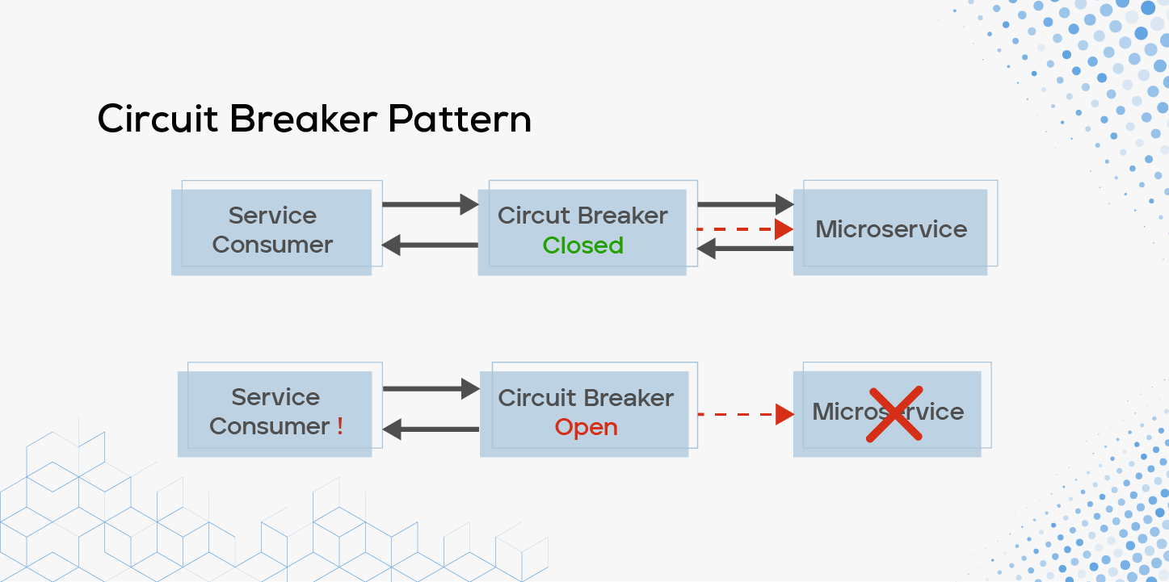
Circuit Breaker Pattern

Slide 53
Circuit Breaker Pattern
Key Concepts
State | Meaning
🔓 Closed | All requests pass through normally
⚠️ Open | Requests fail immediately without calling the service
🔄 Half-Open | A few test requests go through to check if service has recovered

